Slide 1

MongoDB-Part 2

Slide 2
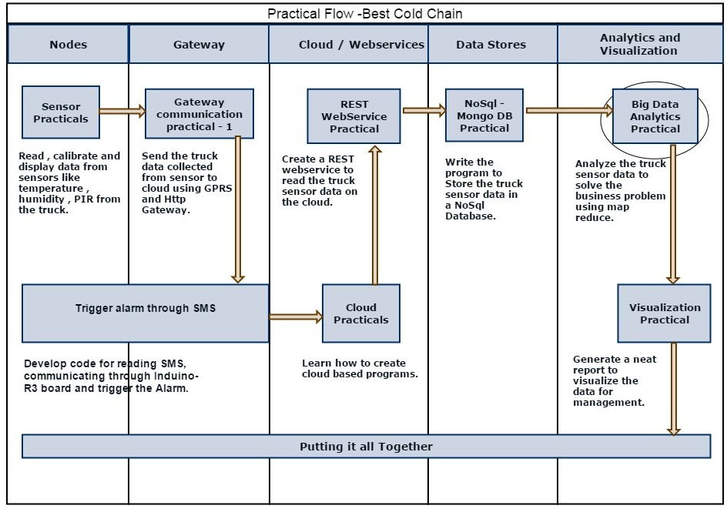
Analytics on IOT platform

Slide 3
Map and Reduce
A map function, which processes documents from your dataset into key-value pairs.
A reduce function, which combines the set returned by map
A reduce function is passed a set of intermediate values and combines them to a single value.

Slide 4
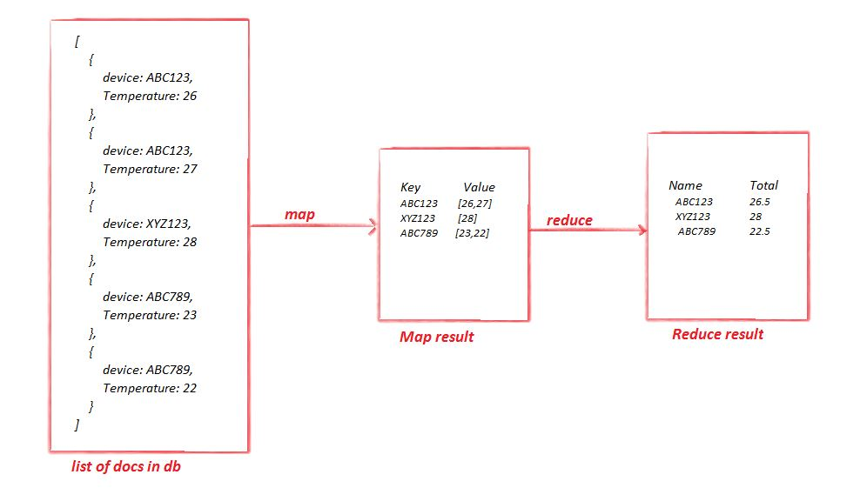
Lets understand MapReduce

Slide 5
MapReduce on mongoDB
Map :
var mapFunction=function(){
emit(key , value);
}
Reduce :
var reduceFunction=function(keys , values){
return <reduced result>
}
Combine above map and reduce :
Db.<collection name>.mapReduce(
mapFunction,
reduceFunction,
{out:”map_reduce_example”}
)

Slide 6
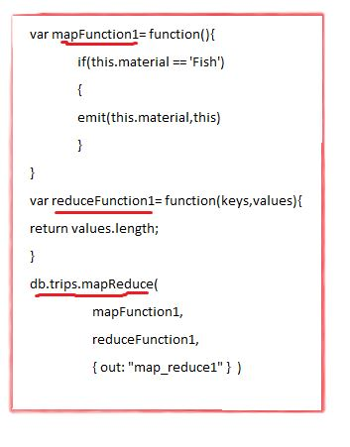
Sample mapReduce on mongo

Slide 7
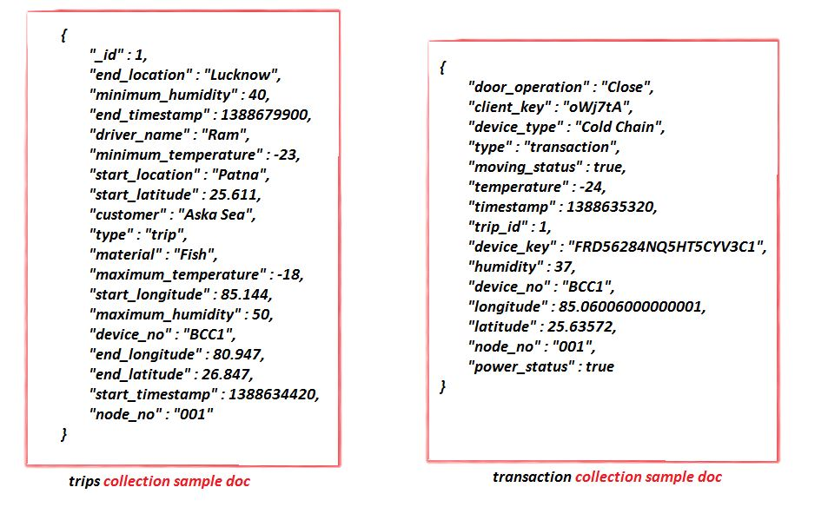
Lets see Practical's
In mongoDB we have taken bcc database which is having two collections transactions and trips

Slide 8
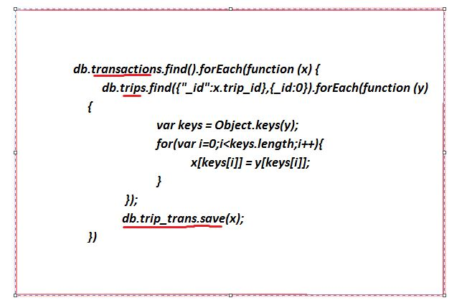
Get all trips for fish where material was spoilt in a particular month
Code for combine two collections

Slide 9
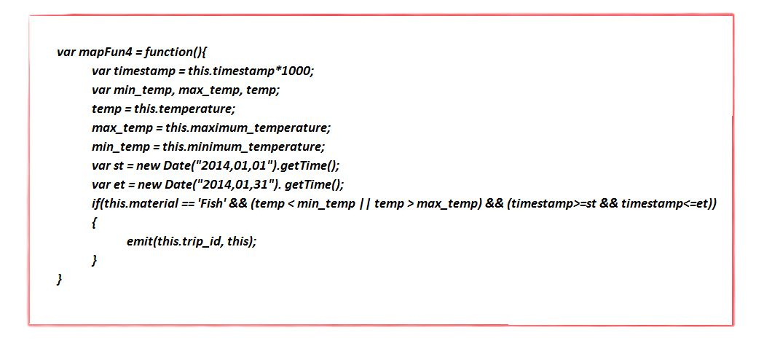
Map

Slide 10
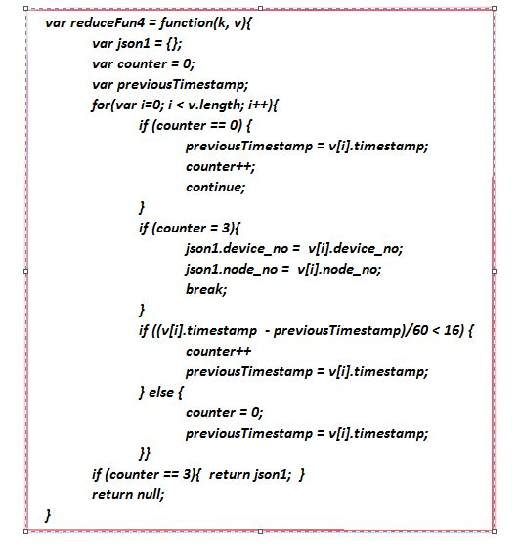
reduce

Slide 11
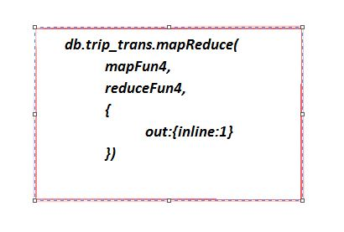
Combine map and reduce

Slide 12
The Business Problem
Best cold chain company is facing huge claims for delivery of spoilt Fish. Below is the number of claims received in last 10 weeks.
Axelta has installed devices on vehicles, these devices sends the data to the Axleta Platform.
Analyze genuine claims by using data.
Customer | Number of Claims
Setu Madhav | 20
Aska sea | 24
Sea Food Express | 24
Al Saad | 18
Astra | 22
Hiran | 28

Slide 13
Thank you

